Slide 1
Parallel and Distributed Computing Lock
Kun Suo
Computer Science, Kennesaw State University
https://kevinsuo.github.io/

Slide 2
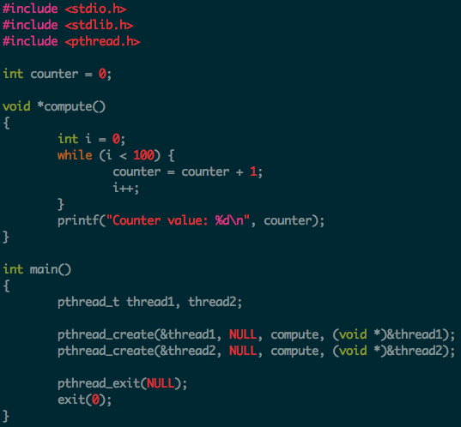
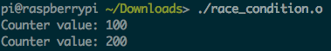
Race condition
https://github.com/kevinsuo/CS3502/blob/master/race_condition.c
A race condition occurs when two or more threads access shared data and they try to change it at the same time.
The order in which the threads attempt to access the shared data makes the results unpredictable
Race condition occurs for variable counter
Seem nothing wrong?

Slide 3
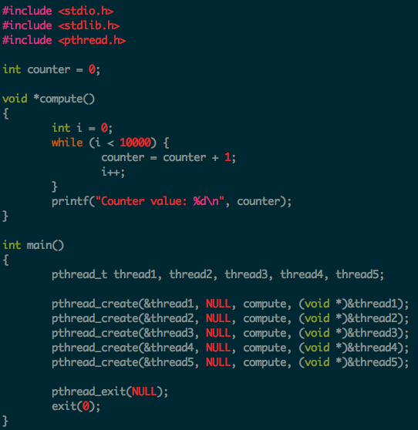
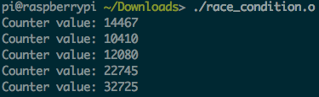
Race condition example
0
10k
20k
Increase the loop number
30k
40k
50k
Add more threads
Weird results!

Slide 4
Critical section
A section of code in a concurrent task that modifies or accesses a resource shared with another task.
Examples
A piece of code that reads from or writes to a shared memory region
Or a code that modifies or traverses a shared linked list.

Slide 5
Critical section example
Critical section: All threads read and write the shared counter

Slide 6
Critical section vs. Race condition
Critical section is where the race condition happens.
When multiple threads visit the critical section, race condition problem appears!

Slide 7
Lock (mutual exclusion)
A lock (mutual exclusion) is a synchronization mechanism for enforcing limits on access to a resource in an environment where there are many threads of execution
Types of mutual mechanism:
Busy-waiting, e.g., spinlock
Sleep and wakeup
Hold
Release
Hold
Release
A
A
Wakeup and Get lock
Get lock
fail and sleep
B
B

Slide 8
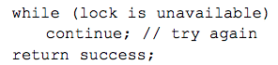
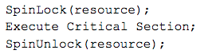
1, Spinlock: A busy-waiting lock implementation
Don’t block. Instead, constantly poll the lock for availability.
Usage: small critical region
Advantage
Very efficient with short critical sections
if you expect a lock to be released quickly
Disadvantage
Doesn’t yield the CPU and burns CPU cycles
Bad if critical sections are long.
Efficient only if machine has multiple CPUs.
Counterproductive on uniprocessor machines
Hold
Release
A
B

Slide 9
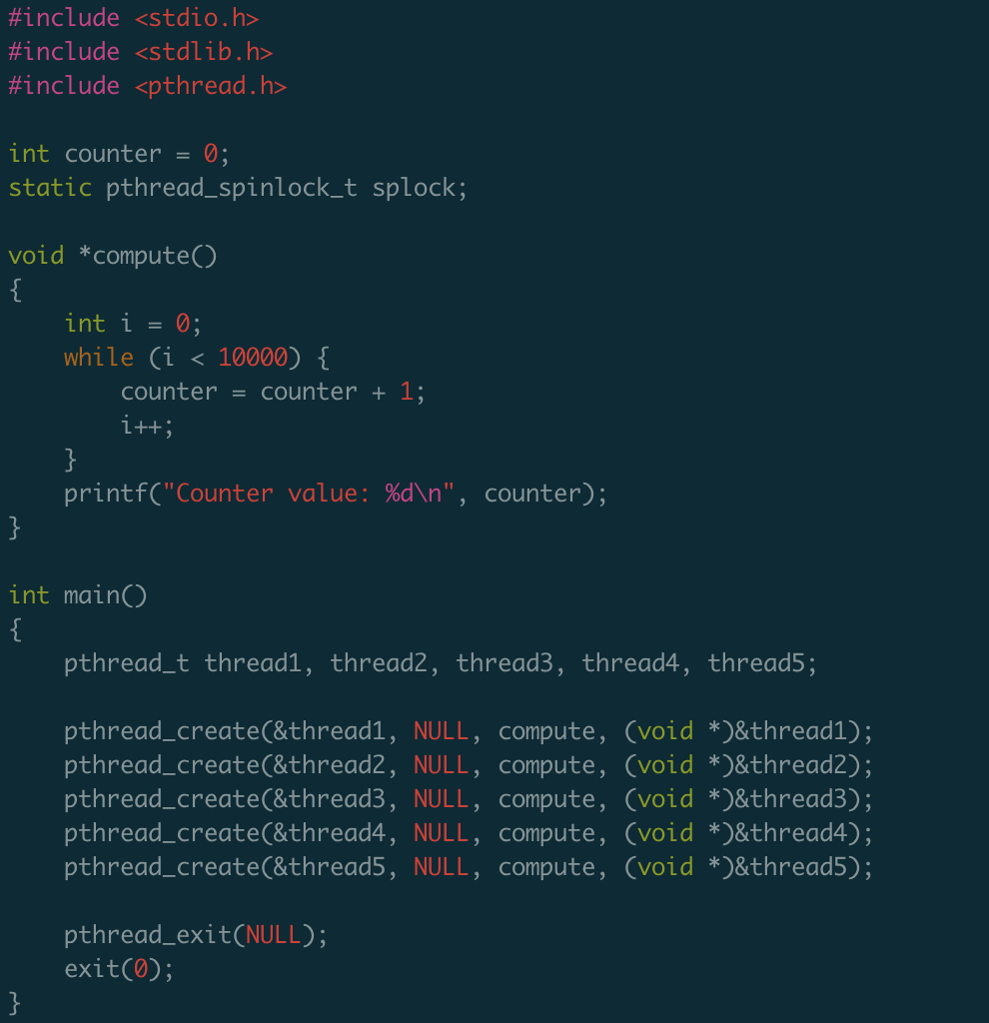
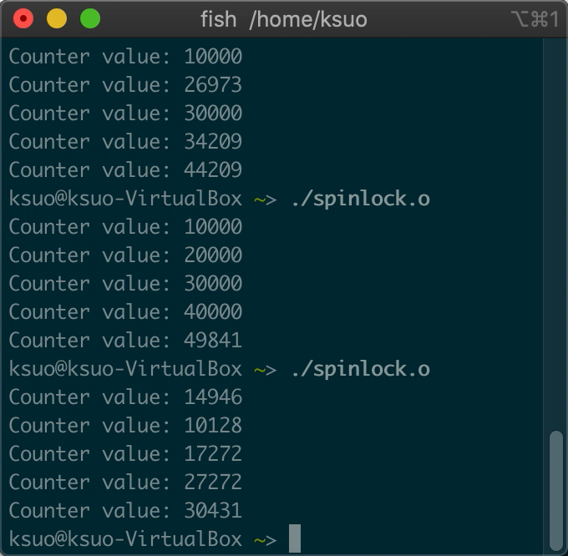
Without Spinlock example
https://github.com/kevinsuo/CS3502/blob/master/spin_no_lock.c

Slide 10
Without Spinlock example
https://github.com/kevinsuo/CS3502/blob/master/spin_no_lock.c
Counter
0
1
6
2
7
3
8
Expected
4
9
5
10
0
1
5
1
4
2
6
Reality
3
6
3
7

Slide 11
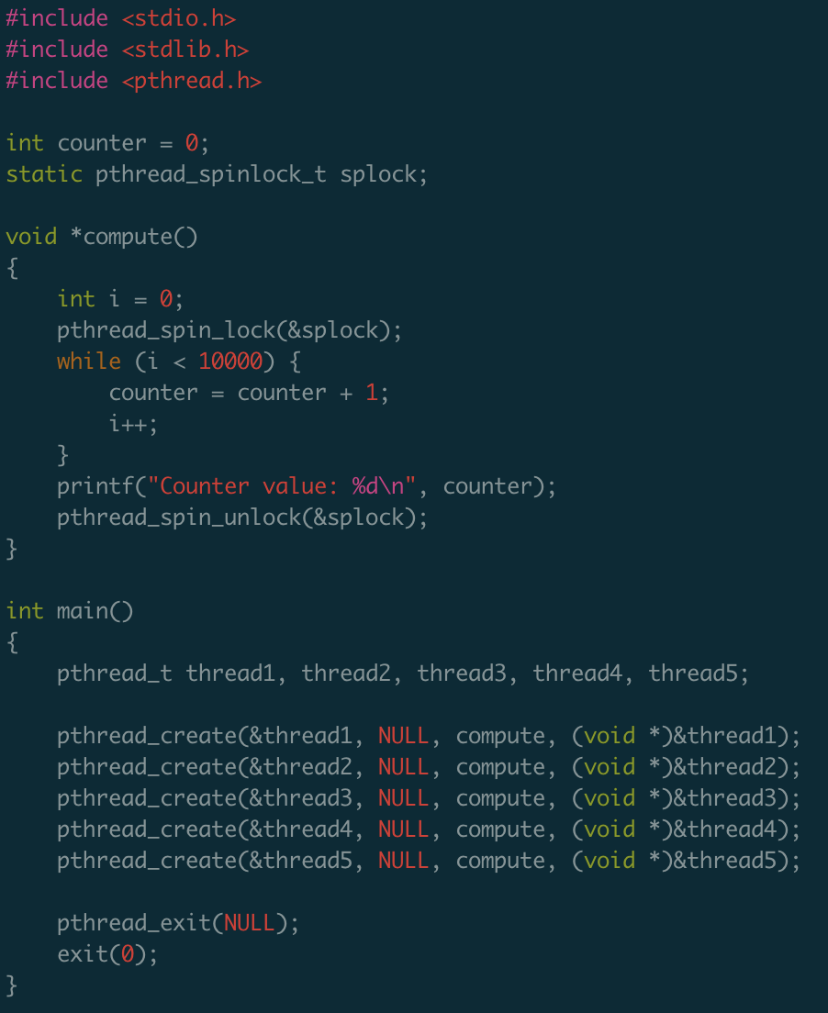
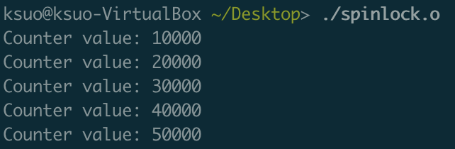
Spinlock example
https://github.com/kevinsuo/CS3502/blob/master/spinlock.c
Hold
Release
A
B

Slide 12

Spinlock example
Hold
Release
A
B
Counter is 0
Counter is 10k
Counter is 20k
Enter critical section
Counter: 1,2,3,…, 10k
Enter critical section
Counter: 10k+1,…,20k

Slide 13
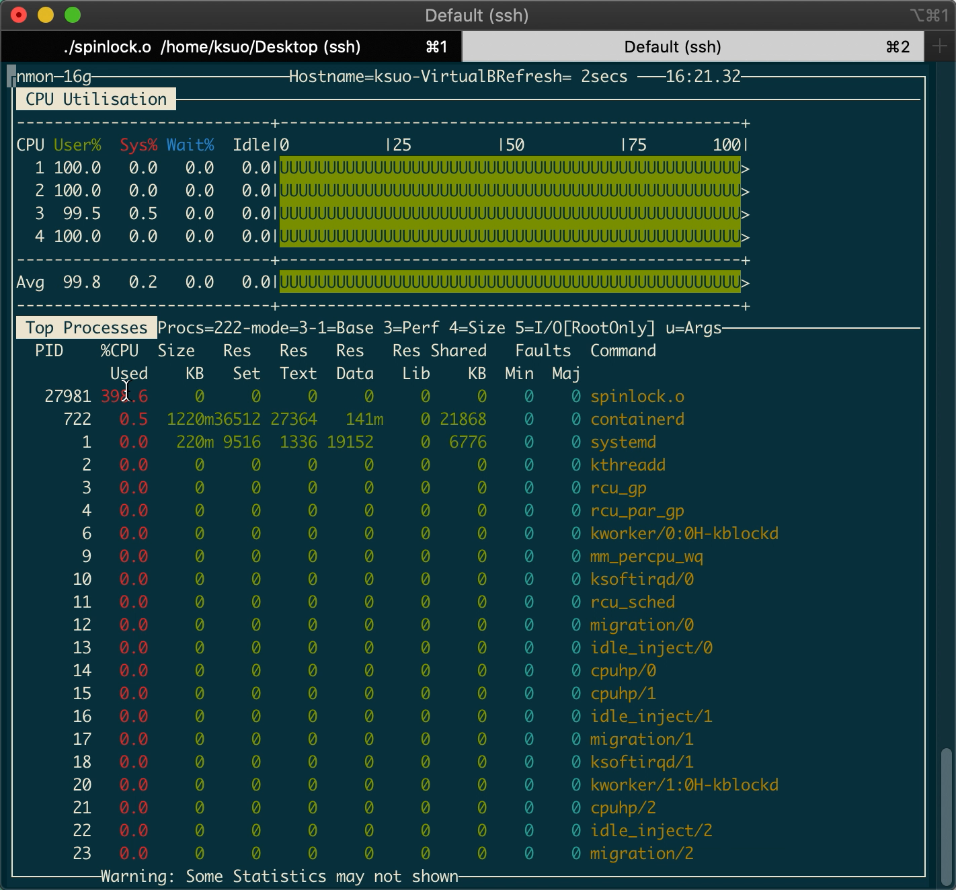
Spinlock example: CPU utilization

Slide 14
Other mutual exclusion similar as busy waiting (spinlock)
Disabling interrupts:
OS technique, not users’
Lock variables:
Test-and-set lock (TSL) is a two-step process, not atomic
Peterson's algorithm
Does not need atomic operation and mainly used in user space application

Slide 15
2, Mutex lock: A sleep-and-wakeup lock implementation
A variable that can be in one of two states: unlocked or locked
Mutex is used as a LOCK around critical sections
Hold
Release
Example:
Lock(mutex)
Critical Section…
Unlock(mutex)
A
Wakeup and Get lock
fail and sleep
B
Pro:
Better cpu utilization
Con:
Overhead on entering sleep or wake up
Not suited for short duration of lock acquisition

Slide 16
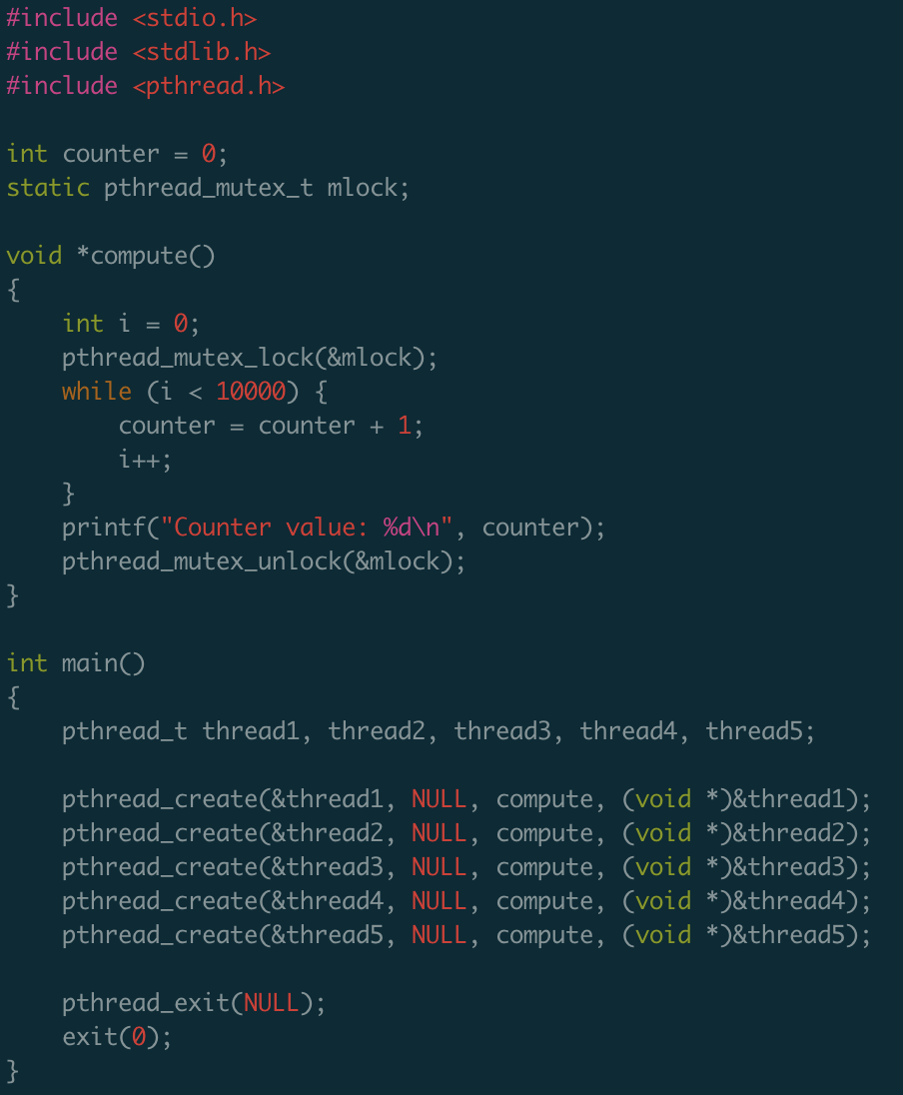
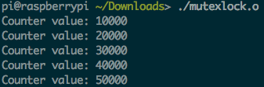
Mutex lock example
https://github.com/kevinsuo/CS3502/blob/master/mutexlock.c
Hold
Release
A
Wakeup and Get lock
fail and sleep
B

Slide 17
Mutex example
Hold
Release
A
Wakeup and Get lock
fail and sleep
B
Counter is 0
Counter is 10k
Counter is 20k
Enter critical section
Counter: 1,2,3,…, 10k
Enter critical section
Counter: 10k+1,…,20k

Slide 18
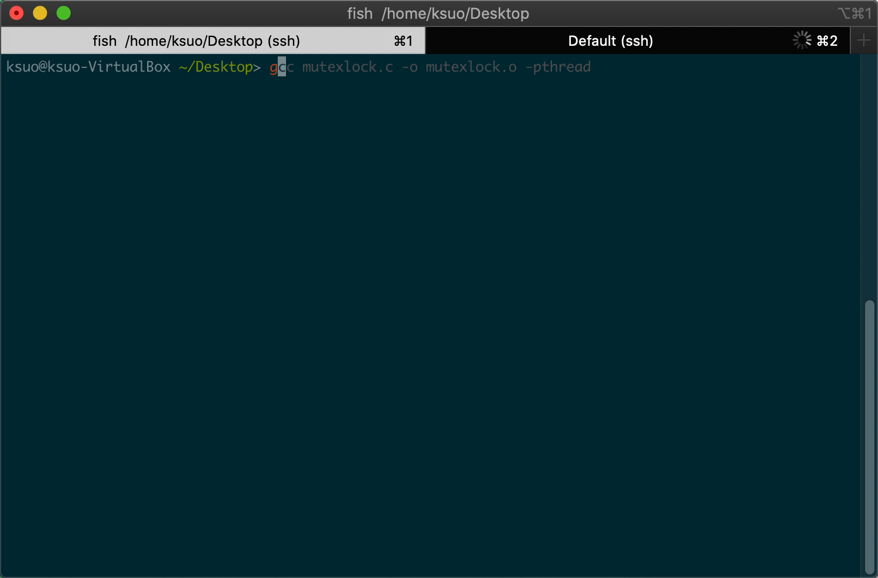
Mutex lock CPU utlization

Slide 19
Busy waiting lock vs Sleep wake up lock
 | Mechanism | Use case | Implementation | Other examples
Busy waiting lock | constantly poll the lock for availability | When the waiting time is short | Spin lock | Disabling interrupts; Lock variables; Peterson’s algorithm
Sleep wake up lock | Sleep if lock not available; wake up if available | When the waiting time is long | Mutex lock | Semaphore

Slide 20
3. Mutex lock with conditions
Mutex locks solve the competition problem of multiple threads accessing the same global variable under the shared memory space. (without conditions)
How about competition with condition variables?
Thread 1
Thread 1
Critical section
x
Critical section
x
Thread 2
Thread 2
I only visited critical section when x >= 100

Slide 21
3. Mutex lock with conditions
Can we use busy-waiting lock?
Thread 1
Enter critical section
Maybe x = 10
Update x
Critical section
x
Thread 2
Enter critical section
???
I only visited critical section when x >= 100
Useless, waste of resources

Slide 22
3. Mutex lock with conditions
Can we use sleep-and-wakeup lock?
Thread 1
Enter critical section
Maybe x = 10
Update x
Critical section
x
Thread 2
Enter critical section
???
I only visited critical section when x >= 100
Useless, waste of resources

Slide 23
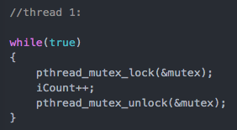
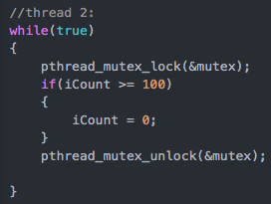

Mutex lock with conditions example
How about competition with condition variables?
Example: T1: increase x every time;
T2: when x is larger than 99, then set x to 0;
T1 and T2 compete for variable iCount!

Slide 24
Mutex lock with conditions example
Thread 1
Critical section
Unpredictable results
iCount
Thread 2

Slide 25
Mutex lock with conditions
How about competition with condition variables?
Example: T1: increase x every time;
T2: when x is larger than 99, then set x to 0;
T2 needs to:
lock;
determine;
unlock;
every time to check

Slide 26
Mutex lock with conditions
Critical section
Thread 1
iCount
iCount
Critical section
Thread 2
iCount = 3
Useless, waste of resources

Slide 27
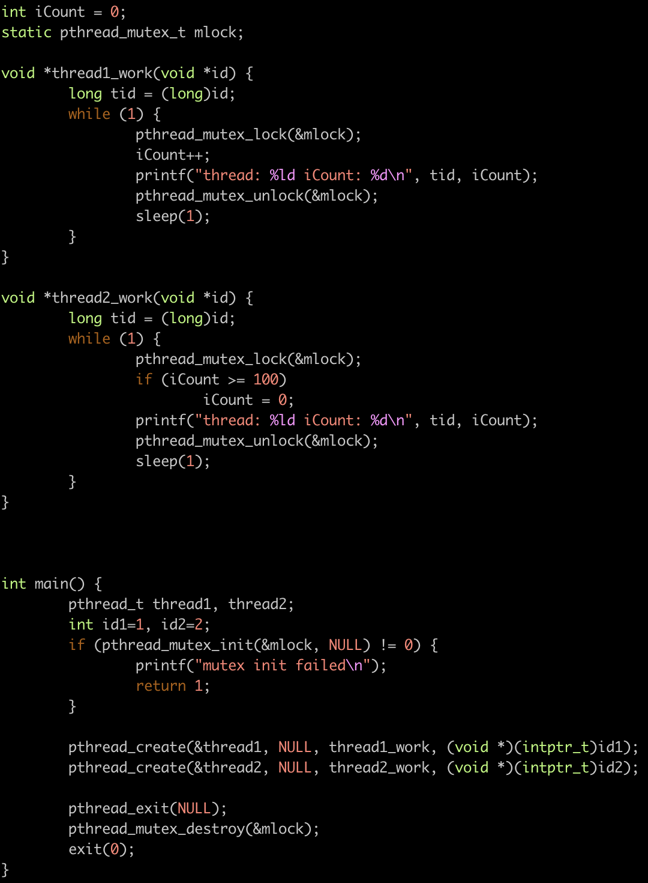
6, condition variable example
Examples
https://github.com/kevinsuo/CS3502/blob/master/lock_wo_condition.c

Slide 28
Pthread_cond_signal and Pthread_cond_wait
Pthread_cond_wait(&condition, &lock)
Pthread_cond_signal(&condition)
Release the lock
Sleep here until condition is reached
When condition is reached, notify all threads waiting for it

Slide 29
Pthread_cond_signal/Pthread_cond_wait v.s. Pthread_mutex_lock/Pthread_mutex_unlock
All threads sleeping will be waked up when lock is released
Thread 1
Thread 2
Thread 3
Thread N
Only wake up the threads with conditions
Thread 1
Thread 2
Thread 3
Thread N

Slide 30
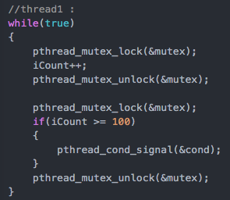
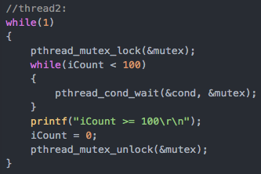
Condition variable
How about competition with condition variables?
Example: T1: increase x every time;
T2: when x is larger than 99, then set x to 0;
When T2 executes here:
1⃣️: release mutex
2⃣️: blocked here
3⃣️: when waked, get mutex and execute

Slide 31


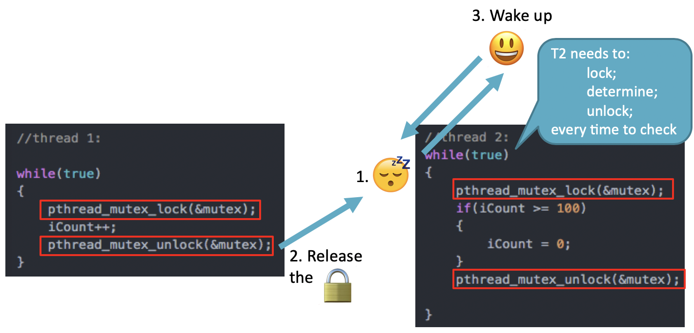
1. Get the
1. Get the
2. release the
2. release the
3. Get the
3. Get
4. release the
4. release the
3. Wake up

Slide 32
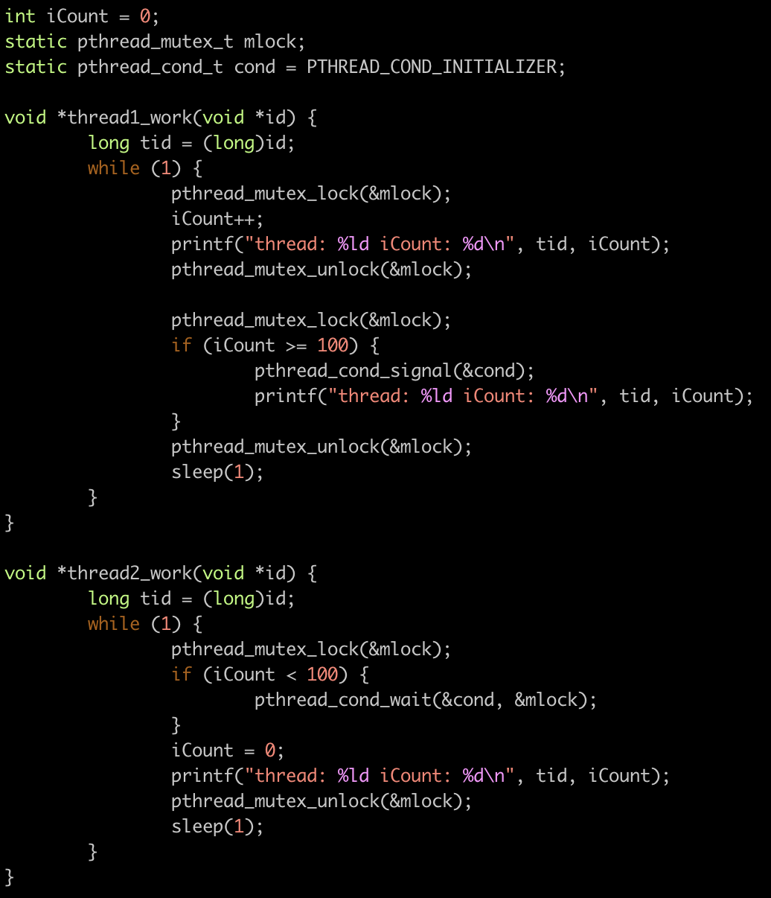
Condition variable example
https://github.com/kevinsuo/CS3502/blob/master/lock_w_condition.c

Slide 33
4. Semaphore
a system of sending messages by holding the arms or two flags in certain positions

Slide 34
4. Semaphore
Semaphore is a variable used to control access to shared resources by multiple processes/threads

Slide 35


Mutex lock and Semaphore
threads
Mutex = 0 or 1
threads
Sem = 0/1/2/3

Slide 36
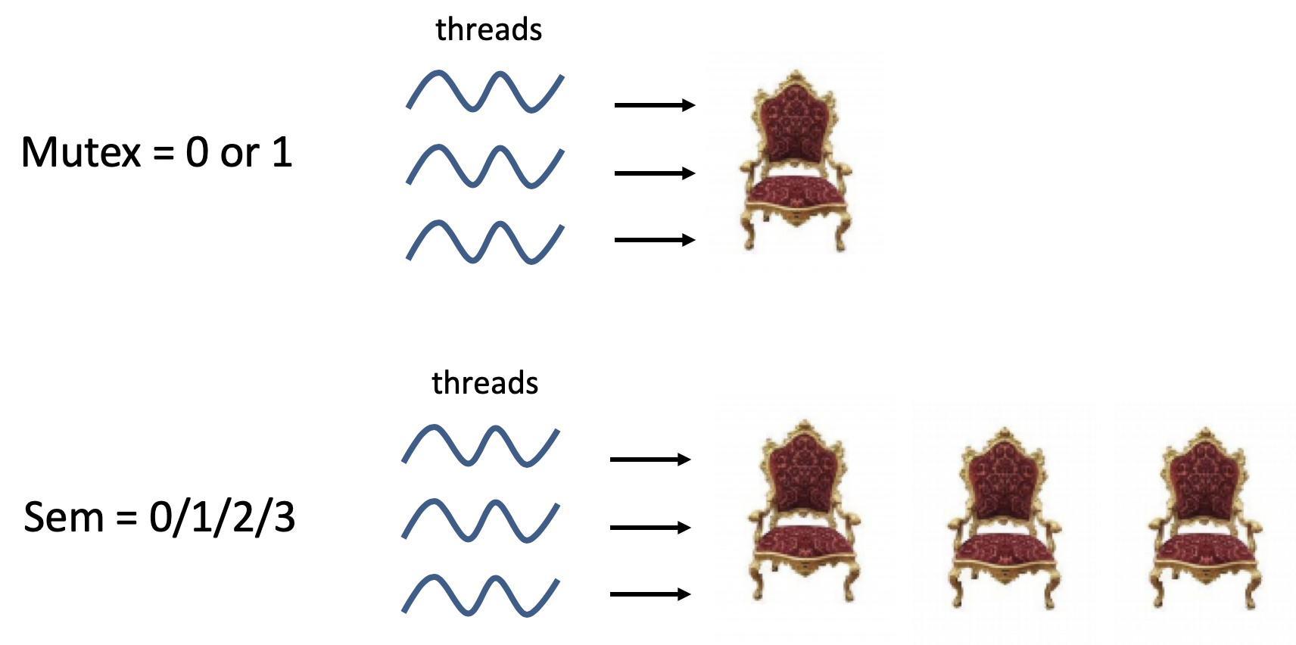
Mutex lock and Semaphore
Mutex lock
Semaphore

Slide 37
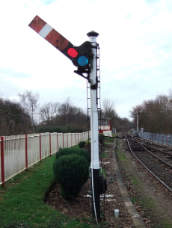
Semaphore
A semaphore “sem” is a special integer on which only two operations can be performed.
DOWN(sem)
UP(sem)
Down operation (P; request):
Checks if a semaphore is > 0, sem--
Request one-unit resource and one process enters
if a semaphore <= 0, wait and sleep
Up operation (V; release)
sem++
Release one-unit resource and one process leaves

Slide 38
Semaphore example
https://github.com/kevinsuo/CS3502/blob/master/semaphore.c
What is the shared resource in this case?
Plate size = 3

Slide 39
Semaphore example
https://github.com/kevinsuo/CS3502/blob/master/semaphore.c
Semaphore of apple (s2):
Daughter: request apple
Father: release the apple
Plate size = 3
Father thread:
peel apple
put apple
V(s2)
Daughter thread:
P(s2)
get apple
eat apple

Slide 40
Semaphore example
https://github.com/kevinsuo/CS3502/blob/master/semaphore.c
Semaphore of pear (s1):
Son: request pear
Mother: release the pear
Plate size = 3
Mother thread:
peel pear
put pear
V(s1)
Son thread:
P(s1)
get pear
eat pear

Slide 41
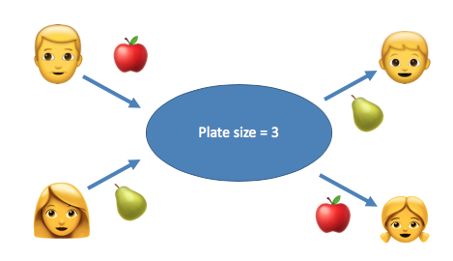
Semaphore example
https://github.com/kevinsuo/CS3502/blob/master/semaphore.c
Semaphore of plate (s3):
Son/Daughter: release the space
Father/Mother: request the space
Father thread:
peel apple
P(s3)
put apple
Mother thread:
peel pear
P(s3)
put pear
Son thread:
get pear
V(s3)
eat pear
Daughter thread:
get apple
V(s3)
eat apple

Slide 42
Semaphore example
https://github.com/kevinsuo/CS3502/blob/master/semaphore.c
Semaphore:
Son: whether there is pear, s1
Daughter: whether there is apple, s2
Father/Mother: whether there is space, s3
Father thread:
peel apple
P(s3)
put apple
V(s2)
Mother thread:
peel pear
P(s3)
put pear
V(s1)
Son thread:
P(s1)
get pear
V(s3)
eat pear
Daughter thread:
P(s2)
get apple
V(s3)
eat apple

Slide 43
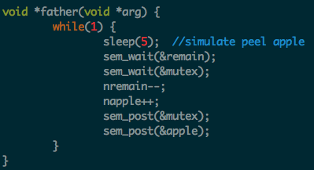
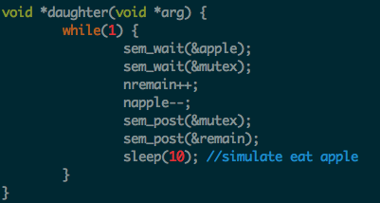
Semaphore example
https://github.com/kevinsuo/CS3502/blob/master/semaphore.c
Semaphore:
Son: whether there is pear, pear
Daughter: whether there is apple, apple
Father/Mother: whether there is space, remain
Father thread:
peel apple
P(remain)
put apple
V(apple)
Daughter thread:
P(apple)
get apple
V(remain)
eat apple
P(s2)
P(s3)
V(s3)
V(s2)

Slide 44
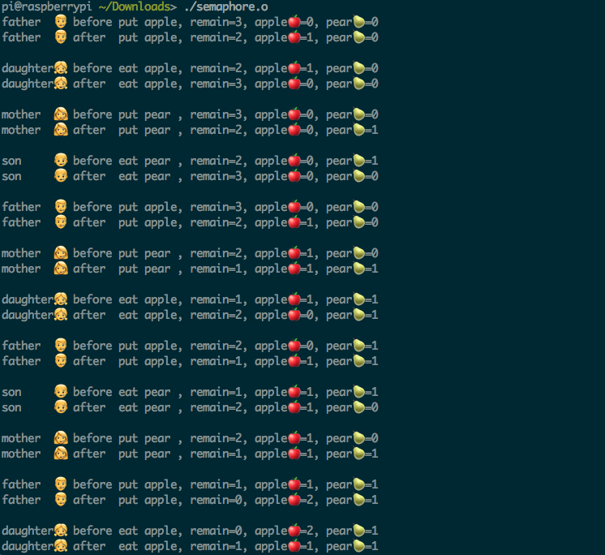
Semaphore example
https://github.com/kevinsuo/CS3502/blob/master/semaphore.c
gcc -pthread semaphore.c -o semaphore.o
https://youtu.be/ZIWwvcuROME

Slide 45
Deadlocks

Slide 46
Deadlocks: philosopher dining
Six people
Three folks
Three knives
Thread 1
m1
Thread 2
m2

Slide 47
Deadlocks
When two or more threads stop making progress indefinitely because they are all waiting for each other to do something.
If process A waits for process B to release a resource, and
Process B is waiting for process A to release another resource at the same time.
In this case, neither A not B can proceed because both are waiting for the other to proceed.
R1
Process A
Process B
R2

Slide 48
Deadlock example
R1
Process A
Process B
R2
Thread 1
Thread 2
pthread_mutex_lock(&R1);
/* use resource 1 */ pthread_mutex_lock(&R2);
/* use resources 1 and 2 */
do_something();
pthread_mutex_unlock(&R2); pthread_mutex_unlock(&R1);
pthread_mutex_lock(&R2);
/* use resource 2 */ pthread_mutex_lock(&R1);
/* use resources 1 and 2 */
do_something();
pthread_mutex_unlock(&R1); pthread_mutex_unlock(&R2);
Stuck right here

Slide 49
A Joke about Deadlock
Interviewer: Explain us the deadlock, and we'll hire you.
Interviewee: Hire me, and I'll explain it to you.

Slide 50


Deadlock example: Priority Inversion
https://www.youtube.com/watch?v=lyx7kARrGeM
https://www.youtube.com/watch?v=t9RM5xcNUak
https://www.rapitasystems.com/blog/what-really-happened-to-the-software-on-the-mars-pathfinder-spacecraft
Wait on T3 I/O processing
Priority: T1 > T2 > T3
T1
Finish I/O work
IRQ happens
T2
1997/07/04 Pathfinder
—> Mars
T3
Priority inversion
High priority tasks proactively give up execution

